Slide 1
Notes:
Imagine that you are walking through a busy street in your city, and your heart rate starts to rise a bit because of what you are about to do.

Slide 2
Notes:
You start overthinking, procrastinating and making excuses. You’re all caught up in what you have to do and you try to make all the anxiety go away.

Slide 3
Notes:
And then, after a few minutes, you sit on your butt and you just lie down in that public place.

Slide 4
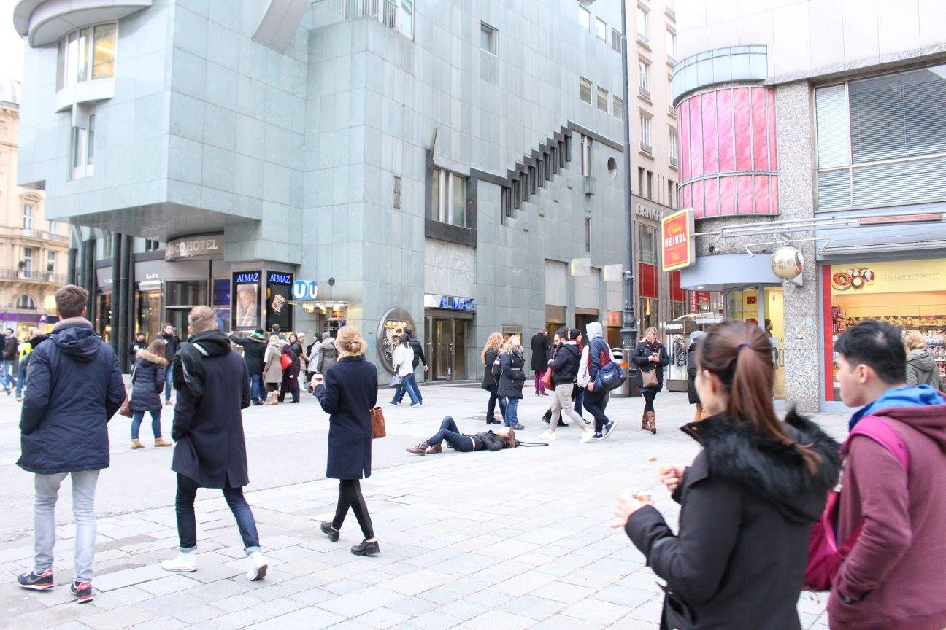
Notes:
That’s a comfort zone challenge. Or more specifically, this is the lie down challenge. This is in Vienna.

Slide 5
Notes:
And this is in a grocery store in Geneva.

Slide 6
Notes:
And a shopping mall in Jakarta. These comfort zone challenges are our way to train psychological flexibility with our clients.

Slide 7
Notes:
This challenge is dancing in public
They’re designed to be safe and they sound like fun at first until you try one. And then you realize that they are very much pushing you outside of your comfort zone and make you feel very uncomfortable.

Slide 8
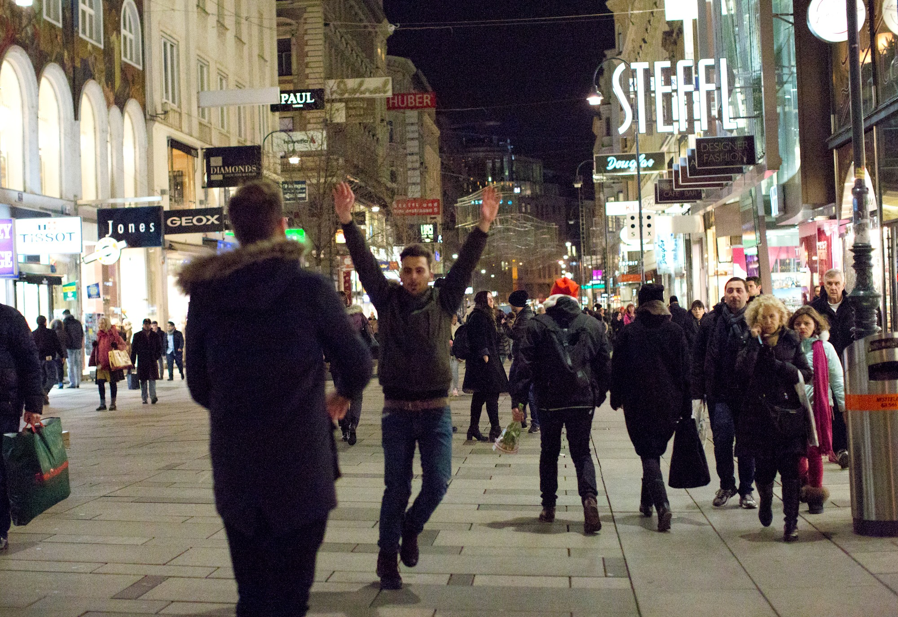
Notes:
Like walking with your hands up in the air.
We tell our participants to not rush this and go through it slowly. To really take the time and get acquainted with their private experiences. We tell them about defusion, acceptance, present moment awareness and all the good stuff.

Slide 9
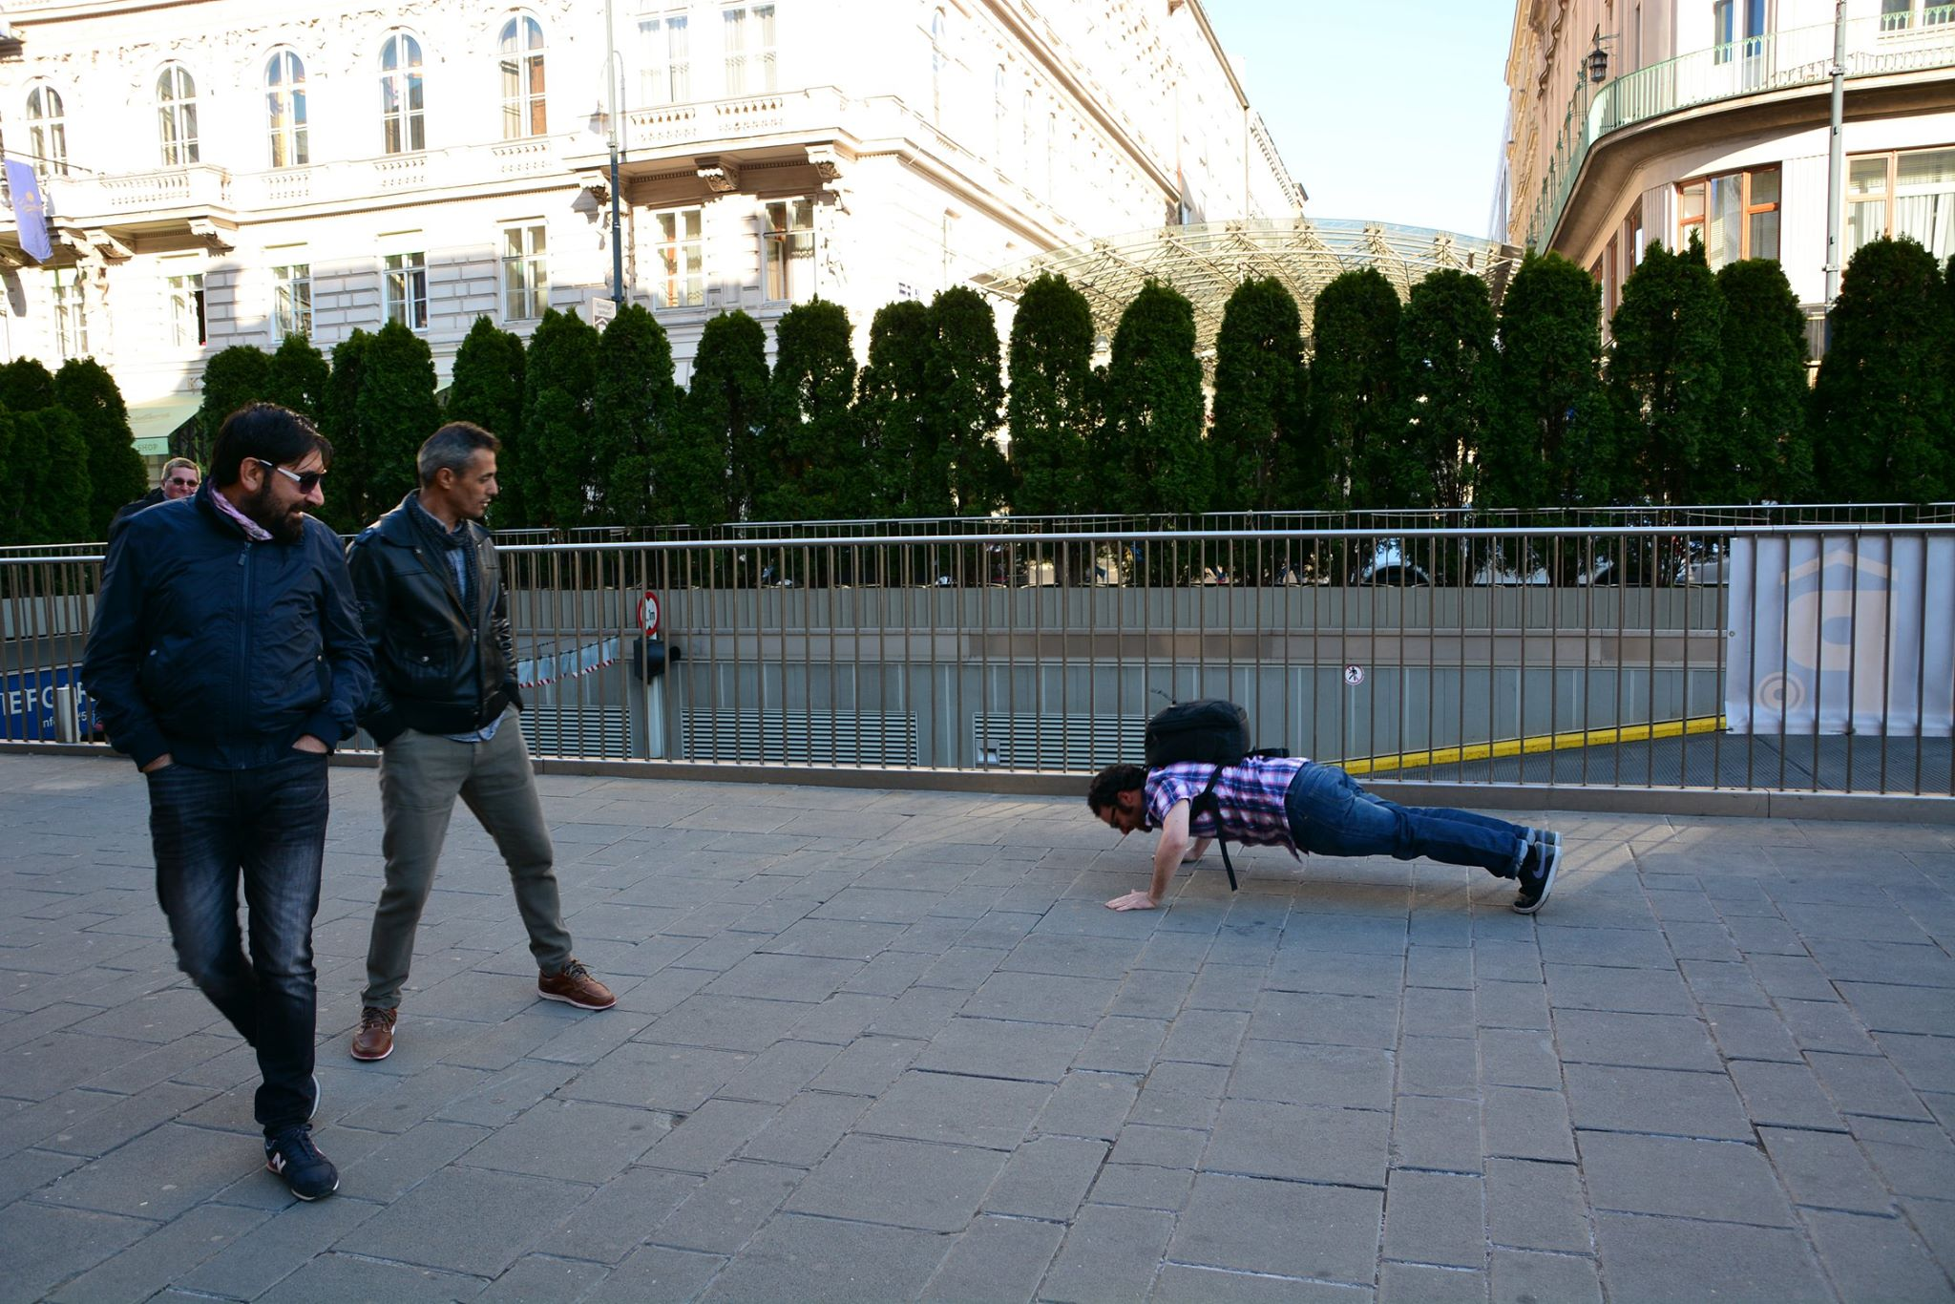
Notes:
Or doing a workout in public

Slide 10
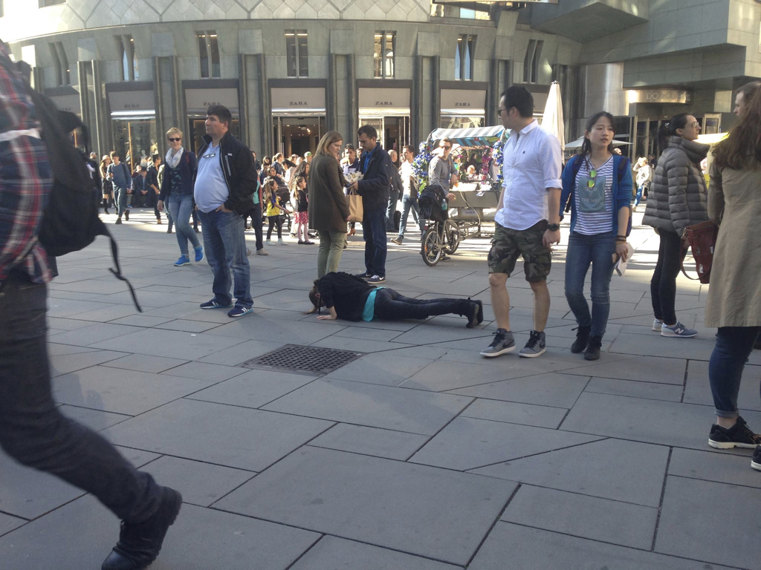

Slide 11
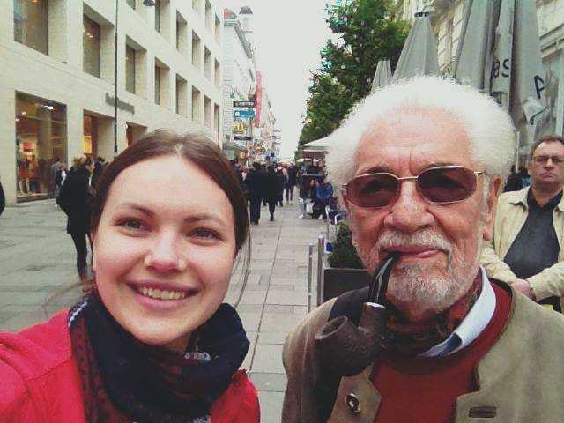
Notes:
And this one is taking selfies with strangers on the street. The previous challenges addressed situations that primarily deal with embarrassment.

Slide 12
Notes:
This is one that deals with another social threat: rejection

Slide 13
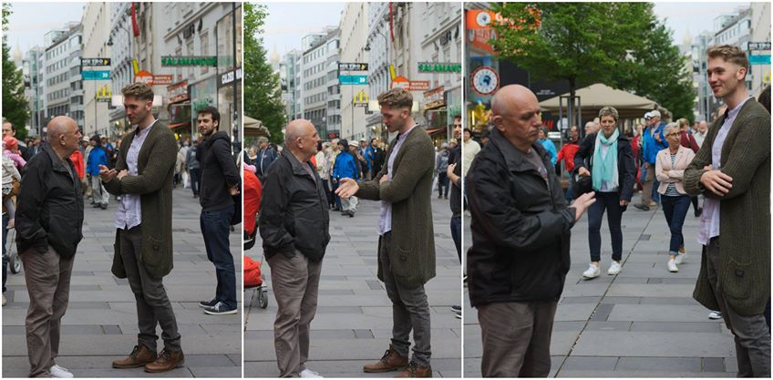
Notes:
And this one is telling jokes to people. By the way, jokes that aren’t even funny.

Slide 15
Notes:
Here someone is trying to get a high-five from strangers

Slide 16
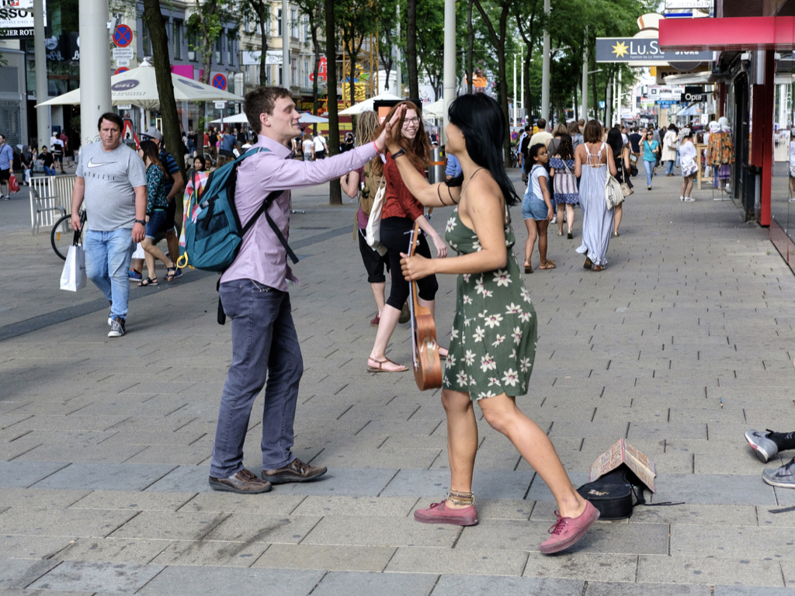

Slide 17
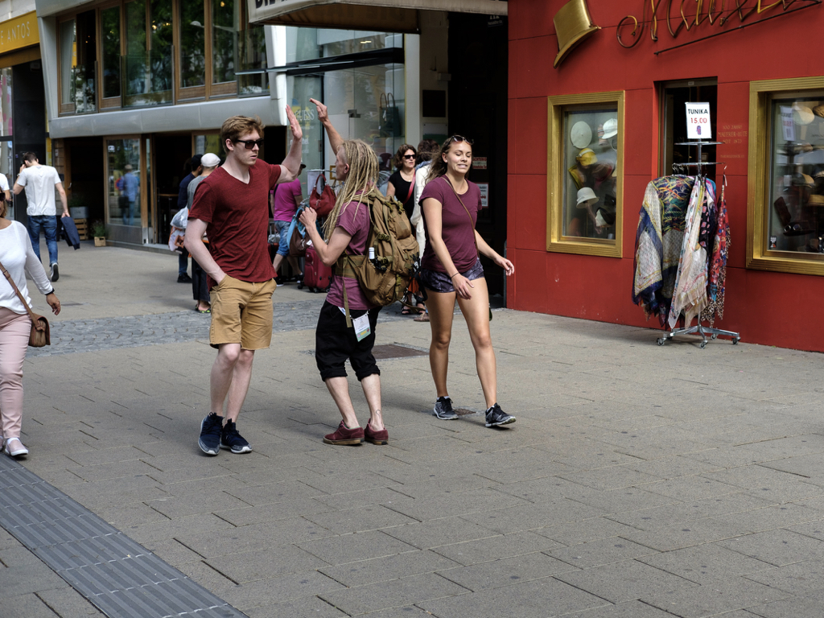
Notes:
And then we use those challenges to have them practice it.

Slide 18
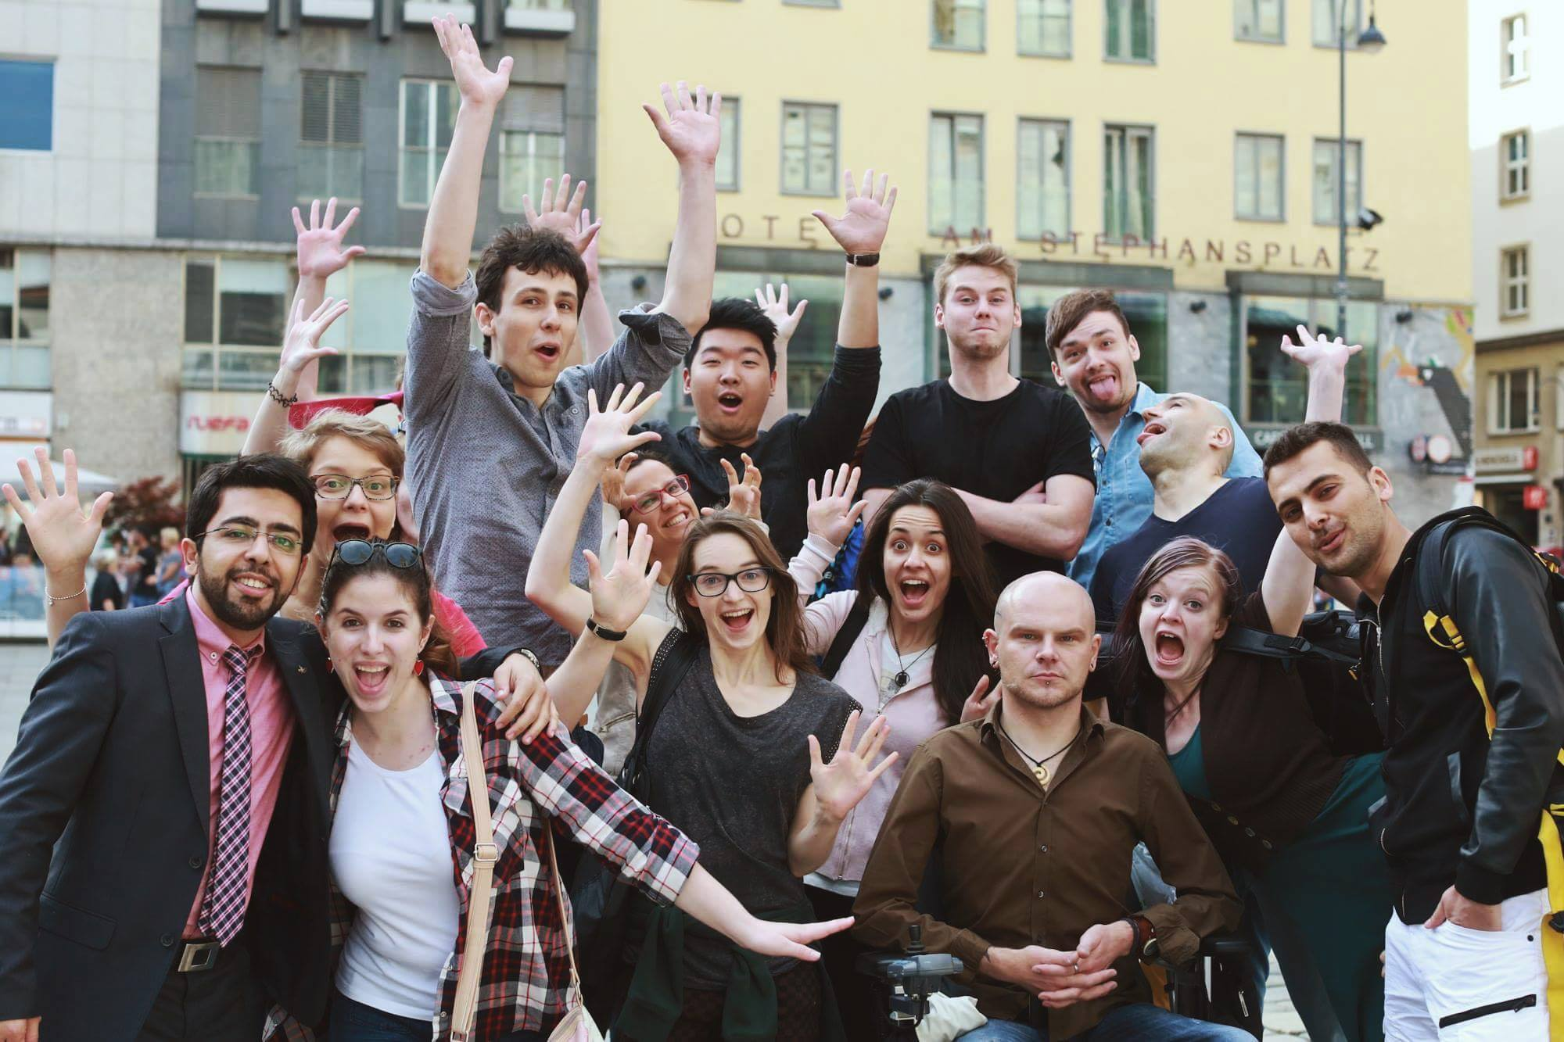
Notes:
So for us at The Art of Charm, this is really a great opportunity to package the science behind ACT in fun exercises that teach young people psychological flexibility while having a lot of fun as well.

Slide 19
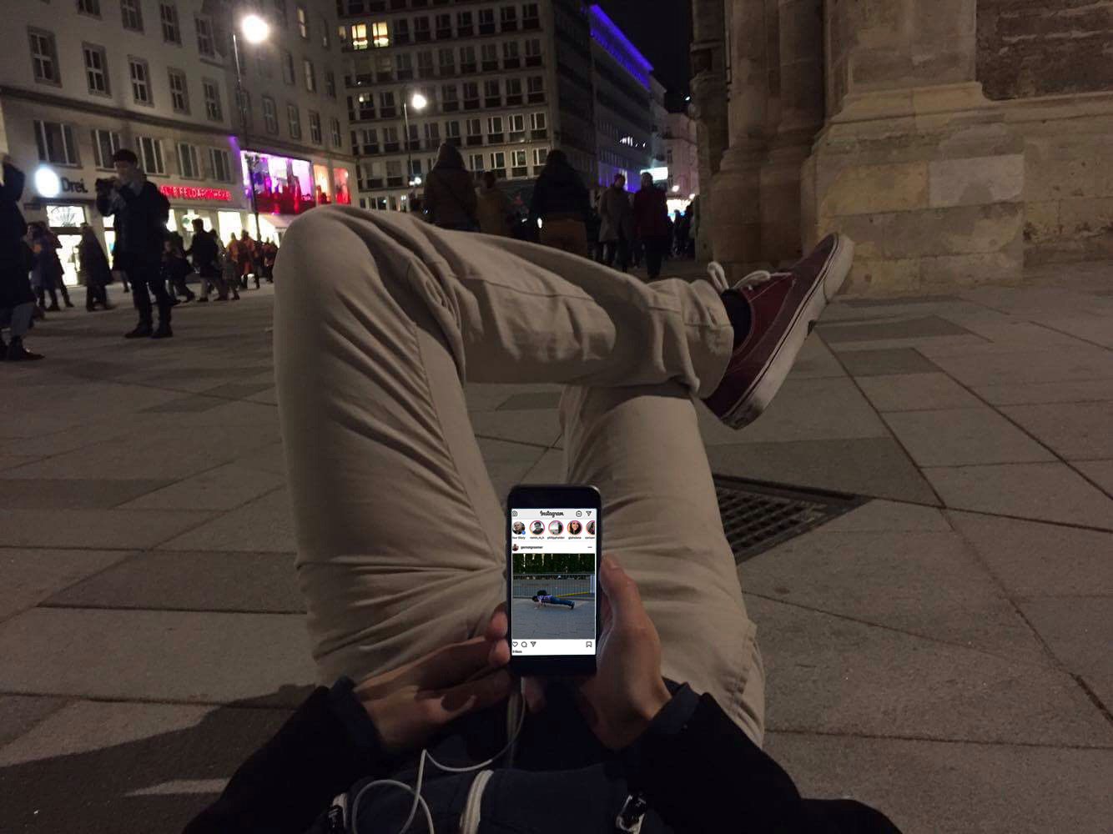
Notes:
And because these comfort zone challenges lend themselves to photos, they get quickly shared on social media, often with a funny anecdote on what happened next. Hashtag Comfort Zone Challenge

Slide 20
Notes:
And this happens in a group setting, so there is always mutual support, and the bonding that happens in these groups is very quick and very strong, because they go through these intense experiences together.

